Slide 1
EUSAIR Governance Support Project 2
StEP
Stakeholder Engagement and Embedding
Meeting between EUSAIR Pillar Coordinators and
EUSAIR Governance Point
online, 12 September 2024

Slide 2
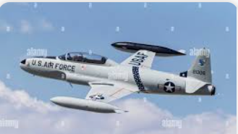
LAUNCHING AND CLOSURE OF 2 MICRO-TENDERS FOR A TEMPORARY ASSIGNMENT OF EXPERTS FOR
1)COMMUNITY AND CONTENT MANAGEMENT AND FOR 2)FINANCIAL DIALOGUE/ EMBEDDING
Market research launched on May 2° (Economic Development Department Decree n°170)
Published on EUSAIR Website and ESP Platform for the assessment of the transboundary interest
Awarded to t33 SRL Company
Kick-off meeting held in Ancona on September 2°
Signature of the 12 months contract to be expected soon

Slide 3
COMMUNITY and CONTENT MANAGEMENT
WP1 and WP2
t33
Workplan
Sept 2024-Aug 2025
Support the StEP Digital Management Team
Asynchronous learning modules (MOOCs)
Support in the organization of events
Management of the repository
Digital mapping of funding opportunities 2021-2027
Preparation of web communication tools
Technical assistance to ESP Stakeholders

Slide 4
SUPPORTING THE EUSAIR FINANCIAL DIALOGUE AND THE EMBEDDING INTO COHESION POLICY
WP4
t33
Workplan
Sept 2024-Aug 2025
Financial dialogue BACKGROUND and METHODOLOGICAL PAPER
Reactivation of
EUSAIR ACTION LABS for ETC MAs
MAs network BACKGROUND AND METHODOLOGICAL APPROACH PAPER
t33
ON-LINE TRANSNATIONAL EVENTS FOR MAINSTREAM MAs
Collection of materials for DESK REVIEW REPORT

Slide 5
SUPPORTING THE EUSAIR EMBEDDING INTO IPAIII PROGRAMMES
WP5
Tendering procedure under PRAG regulations launched and finalized
29° July 2024: signature of the contract
Awarded to Naxta SRL Company
WP leader: DEI

Slide 6
Next steps
B2B meetings with Pillar Coordinators for the preparatory development of ESP Database (Fall 2024)
Reactivation of the ETC MAs network (3 Action labs webinar events from December 2024 to July 2025)
Having the procedure above the EU threshold officially launched by December 2024
On-line transnational events for Mainstream MAs (Spring/Summer 2025)

Slide 7
Public procurement tender for a technical assistance company above the EU threshold
From Sept 2025
to Dec 2027
Preliminary market consultation according to art. 77 D.Lgs. 36/2023 launched on July 22° (Economic Development Department decree n° 344)
Published on EUSAIR Website and ESP Platform for the assesment of the transboundary interest
Deadline for submitting contributions postponed from August 30° to September 20°,
procedure still ongoing
Preliminary contributions received from ICT companies and start-ups

Slide 8
Public procurement tender for a technical assistance company above the EU threshold: WP1 and WP2
User management and profiling
From Sept 2025
to Dec 2027
Real-time cooperation environment for different stakeholder groups
What
is StEP
expecting for ESP upgrade?
Data knowledge management
Multilingual automatic transcription and translation
Integration with models and applications already developed
AI-based applications
Setting up and animating the EUSAIR financial dialogue
Enhanced e-learning functionalities

Slide 9
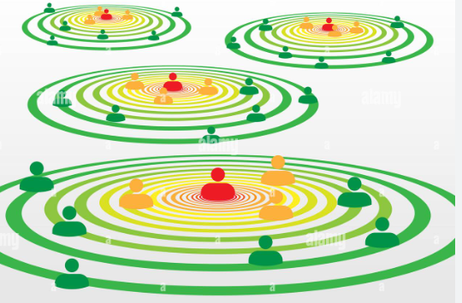
Public procurement tender for a technical assistance company above the EU threshold: WP4
From Sept 2025
to Dec 2027
What
is StEP
expecting for financial dialogue and embedding
PERMANENT ACTION LABs : permanent laboratory for ETC MAs network
GUIDANCE PAPERS for:
development of MAs networks
- for embedding in 2028-2032 progr. period
Financial dialogue
on-line MATCHMAKING ENVIRONMENT
Establishment of the MAINSTREAM MAs NETWORK

Slide 10
THANK YOU FOR YOUR ATTENTION
StEP working group

